Slide 1
CFS
11
Your Credit and
Your Clearance

Slide 2
Military Policy on Indebtedness
“Members of the Military Services are expected to pay their just financial obligations in a proper and timely manner.”
Enforcement of private obligations is a matter for civil authorities

Slide 3
Creditor Complaints
Creditor complaints sent to a CO
State protections
Branch-specific guidance
SM 11-4

Slide 4
Military Response to Member Indebtedness
The Military (including COs) MAY NOT:
Require a Service member to pay a private debt
Deduct a Service member’s pay to reimburse a creditor
The Military (including COs) MAY:
Refer correspondence or debt complaints to the Service member
Determine when a Service member’s failure to pay debt is “irresponsible”

Slide 5
Military Career Implications
“Irresponsibility” can lead to:
Lower evaluations
Negative entry on Service member’s record
Ineligible to promote / advance
Loss of duty assignment
Ineligible for special duty
Denied re-enlistment
Loss of security clearance
Disciplinary action, up to and including separation from service

Slide 6
Garnishment
Creditors may seek enforcement of civil judgments.
COs must notify the Service member of the involuntary allotment and inform Service member of their right to consent or contest it.
 | Garnishment Amount | Processed by
DoD | 25% of disposable pay per month | DFAS
DHS | 25% of pay subject to involuntary garnishment | USCG Pay & Personnel Center
SM 11-5

Slide 7
Role of CFS
Help the Service member create a budget
Include delinquent accounts
Provide credit management training
Make appropriate referrals
Installation Personal Financial Manager or Counselor
Legal
CFPB or FTC for complaints of inappropriate collection actions

Slide 8
Debt Complaints Discussion
What have you seen?
SM 11-6

Slide 9
Security Clearance Basics
What organizations manage this process?
VROC: Vetting and Risk Operations Center
Establishes vetting process and automated record checks
DoD CAF: Department of Defense Consolidated Adjudications Facility or SECCEN: USCG Security Center
Investigates and makes decisions (adjudicates)
Security Management Office (SMO) or Command Security Officer (CSO)
Liaison at the command level

Slide 10




VROC Continuous Evaluation
Terrorism
Professional Review, Actions
Monitor
Foreign TRAVEL
CE database
Monitoring
Alert
Generated
Verified By DCSA
Suspicious Financial Activity
Criminal Activity
Mitigate
Credit
Public Records
MANAGE
Eligibility

Slide 11

DoDCAF/SECCEN Adjudication
Receives Alert from VROC
Investigates through SMO or CSO
Uses “whole person” concept to make a decision
Top 5 Issues
1. Criminal Conduct
2. Financial Considerations
3. Foreign Influence
4. Personal Conduct
5. Drug Involvement
and Substance Misuse

Slide 12


Whole Person Considerations
DISQUALIFYING FACTORS
MITIGATING FACTORS
Unable or unwilling to resolve debts
Frivolous or irresponsible spending
Recurrent pattern of financial instability
Deceptive or illegal practices
Living beyond one’s means
Unexplained affluence
Compulsive or addictive gambling
Tax fraud or failure to file or pay taxes
Behavior: Distance, frequency, or circumstances do not cast doubt on individual
Conditions: Conditions were beyond person’s control and they acted responsibly
Counseling: The person has or is receiving counseling and problem is being resolved.
Repayment: The individual initiated and is adhering to a good-faith effort to repay.
Legitimacy: The individual has a reasonable basis to dispute the past-due debt.
Legality: The affluence resulted from a legal source of income.
Compliance: The individual made arrangements with the appropriate tax authority and is complying with those arrangements.

Slide 13
DoD: Statement of Reasons
A Statement of Reasons (SOR) is issued when DoD CAF is considering an unfavorable security eligibility determination (revoke or deny)
The SOR includes:
Attachment 2: Statement of Reasons Receipt and Statement of Intent (10 days)
Attachment 1: Statement of Reasons (30 days)
Attachment 3: Form(s) for requesting records
Attachment 4: Instructions for responding to an SOR
Attachment 5: National Security Adjudicative Guidelines
Attachment 6: Applicable National Security Adjudicative Guidelines
SM 11-8

Slide 14
DoD Response Timeline for SOR
Command IMMEDIATELY presents SOR
to Service member
Service member acknowledges receipt
(10 days)
Service member prepares response
(30 days)
DoD CAF sends SOR to Command
SMO

Slide 15
DoD SOR: Role of CFS
Assist the Service member to create budget and good-faith action plan
Assist Service member to secure a credit report
Discuss dispute process for credit report errors
Discuss with member the importance of documentation to support ALL claims made in response letter
Discuss the importance of member being proactive in addressing issues and seeking financial counseling when difficulties occur
More than one meeting may be needed for SOR cases
Always refer when needed
SM 11-14

Slide 16
DHS: Letter of Intent
A Letter of Intent (LOI) is issued when SECCEN is considering an unfavorable security eligibility determination, that is, intent to revoke or deny security clearance or eligibility.
The LOI includes:
Lists of disqualifying factors
LOI receipt acknowledgement form letter
SM 11-19

Slide 17
DHS: LOI Received at Command
SECCEN
Sends LOI to
Service member via their CO and security manager
Command
IMMEDIATELY ensures acknowledgement is signed and returned
Acknowledgement does not admit fault; it only is a statement of receipt of the LOI
Service
Member
No response from Service member will result in SECCEN taking action described in LOI
Prepares response for submission within 30 days

Slide 18
DHS LOI: Role of CFS
Assist the Service member to create a realistic budget
Refer Service member for further assistance
PFM at the Office of Work-Life
Legal
Prepare Service member for PFM counseling:
LOI
Completed FPW or list of current income and expenses
Copy of credit report
Supporting documentation
SM 11-23

Slide 19
Knowledge Check and Summary
Questions about indebtedness or SORs/LOIs?
Is the CFS role remedial, proactive or preventive related to indebtedness?
What financial education topics are most relevant to issues of indebtedness and SORs/LOIs?
What value could a CFS provide to command leadership in this area?

Slide 20
Break!

Slide 21
Avoiding SORs/LOIs through Credit and Debt Management
21
Your credit impacts your clearance
Check your credit report
Build credit strategically
Repair damaged credit / debt repayment
SM 11-25

Slide 22


How Does Credit Impact Your Life?
Housing
Insurance
Employment
Security Clearances
Overseas Assignments

Slide 23



Understanding Credit Reports
Detailed account of your credit
Used to determine creditworthiness
Check annually
Where can you check this for free?
www.annualcreditreport.com

Slide 24
Credit Report Contents
Inquiries
Public record information
Payment history
Accurate negative information
Identification
SM 11-26
Notes:
Pull credit report and do checklist

Slide 25
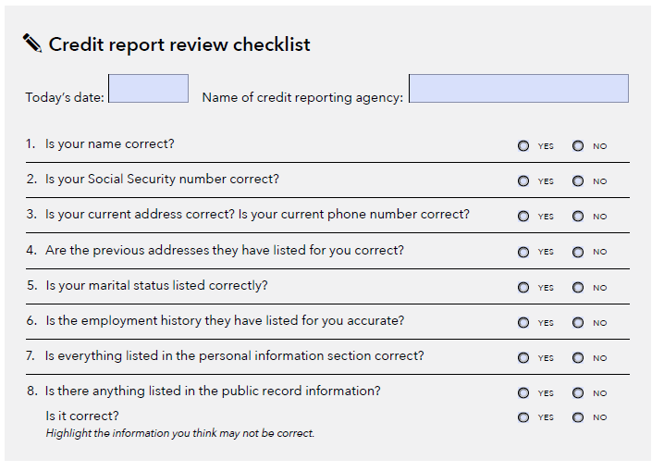
Activity: Credit Report Checklist, page 1
SM 11-26
Notes:
Pull credit report and do checklist

Slide 26
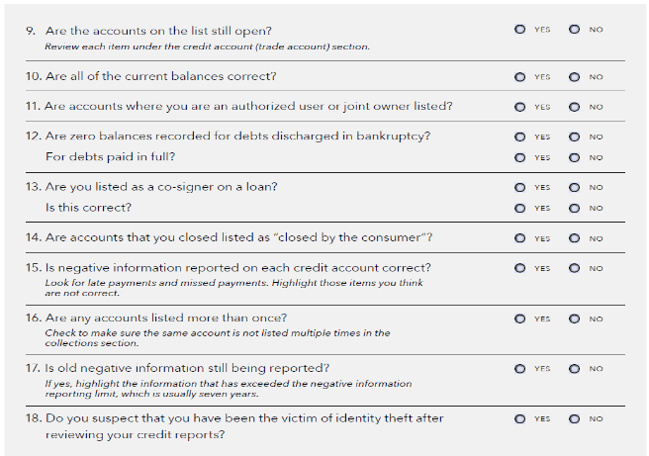
Activity: Credit Report Checklist, page 2
SM 11-26
Notes:
Pull credit report and do checklist

Slide 27
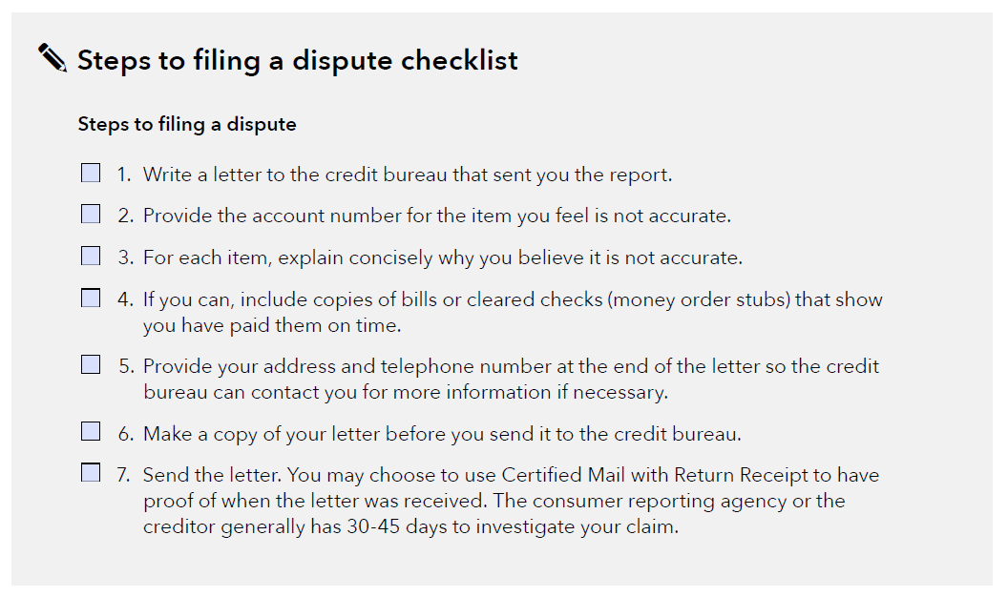
Activity: Credit Report Checklist, page 4
SM 11-26
Notes:
Pull credit report and do checklist

Slide 28
The Credit Score
FICO Scores by Percent of Scorable Population
FICO Score Ranges | Rating | Description
< 580 | Poor | Your score is well below the average score of U.S. consumers and demonstrates to lenders that you are a risky borrower.
580 - 669 | Fair | Your score is below the average score of U.S. consumers, though many lenders will approve loans with this score.
670 - 739 | Good | Your score is near or slightly above the average of U.S. consumers and most lenders consider this a good score.
740 - 799 | Very Good | Your score is above the average of U.S. consumers and demonstrates to lenders that you are a very dependable borrower.
800 + | Exceptional | Your score is well above the average score of U.S. consumers and clearly demonstrates to lenders that you are an exceptional borrower.
SOURCE: https://www.myfico.com/credit-education/what-is-a-fico-score

Slide 29
The Five Components of a Credit Score
10%
Credit Mix
Whether there is a mix of different types of credit, such as a mortgage, a credit card, and an installment loan
10%
New Credit
Whether there are new requests for credit/credit inquiries on the account
10%
10%
35%
Payment History
Whether payments are made on time
35%
15%
15%
Length of Credit History
How long an account has been open
30%
30%
Amounts Owed
How much revolving credit and loans you are using

Slide 30
Play to Win! Focus on Highest Scoring Areas
Payment history is 35% of score
Set minimum auto payments
Avoid delinquencies and collections
How much you owe is 30% of your score
Pay in full monthly
Don’t exceed 6% of credit limit
Save for large purchases
Time is 15% of your score
Choose the right cards
Keep card longer

Slide 31
Strategies to Build Credit
No credit and bad credit — both are a detriment
Build credit strategically
Build good score first to reduce loan rates
Credit cards can build credit cheaply, if done right
Be cautious of line of credit products

Slide 32
No One Wants to Give Me Credit
Find cards with no score required
Talk to your bank or credit union
Apply for a retail card
Consider a secured card

Slide 33
Strategies to IMPROVE Credit
Meet with CFS or Personal Financial Manager / Counselor for a spending plan
Live below your means
Stop spending on credit
Use debt repayment plan
Contact creditors
Lower your interest rates
SCRA
Focus on highest scoring areas
Change behaviors

Slide 34
Protect Your Credit
“Active-Duty Alert”
Check for identity theft
Sign up for free credit monitoring
Limit powers of attorney
Change your address with all creditors
Use credit freeze cautiously

Slide 35
The Cost of Credit
How long you take to repay
How much you pay each month
How much you borrow
Where you borrow

Slide 36
Where You Borrow
Predatory Lenders
Retail Merchants
Consumer Finance Companies
Savings and Loans Associations
Commercial Banks
Credit Unions

Slide 37
Managing Your Debt
Used wisely, credit can be a good thing
Avoid becoming overextended
Be aware of your debt-to-income ratio

Slide 38
Warning Signs
Unable to pay bills
Unable to afford car
Bounced checks
Spouse lost job
Divorce / separation
Not enough money
No emergency fund
Over your head in debt
Facing foreclosure
Can’t sell your home
What can the CFS do?

Slide 39
Summary
Military personnel must address indebtedness
Financial issues impact security clearances
Manage credit and debt
Check your report regularly
Use a debt repayment plan
Calculate debt-to-income ratio

Slide 40
Questions?
The appearance of U.S. Department of Defense (DoD) visual information does not imply or constitute DoD endorsement.

