Slide 1

CFS
15
Developing
Your Program

Slide 2
Topics
“What Have You Learned?” Activity
Purpose of the Course
Developing a Command Program
Financial Program Resources
Maintaining Your Certification
CFS Panel Discussion
Post-test

Slide 3
What Have You Learned?
GOOD
BAD
Positive
Negative

Slide 4
Course Terminal Objectives
Upon course completion, learners should be able to:
Manage a PFM Program at the Command Level
Conduct Effective PFM Education and Training
Provide Appropriate Information and Referral
Conduct Effective One-on-one Counseling / Coaching

Slide 5
CFS Responsibilities
Do you know your CFS responsibilities?
To whom do you report?
Who is your CFS Chain of Command?
SM 15-3
15-3

Slide 6
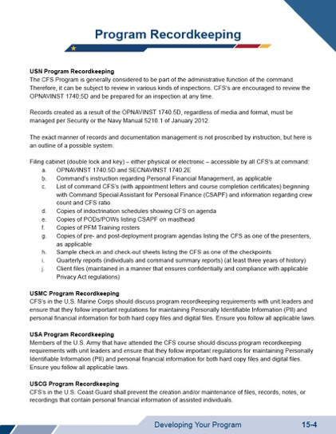
CFS Program Recordkeeping
SM 15-4

Slide 7
Steps to Developing a Program
Talk to the command
Engage your leadership
Offer services based on need
SM 15-5

Slide 8
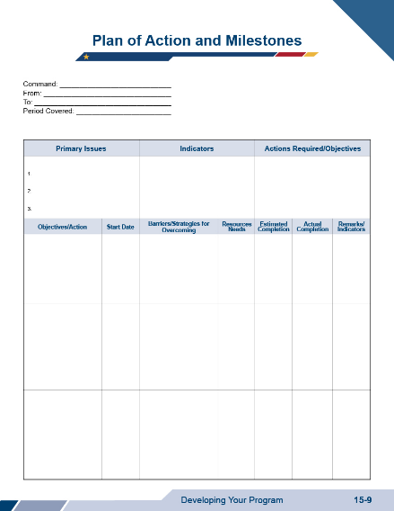
Developing Program Goals
SM 15-9

Slide 9

Marketing Your Program

Slide 10
Command Briefs
Command Leadership
Audience: Command senior leadership
Content: Goals, expectations, and trends for your program
Command Indoctrination (INDOC)
Audience: New command members
Content: Financial training and resources offered at the command

Slide 11
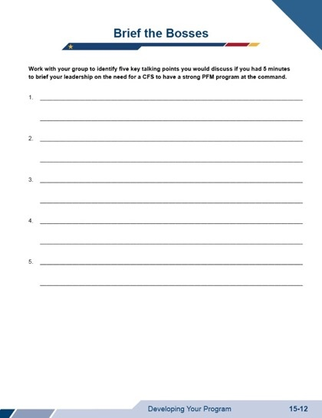
Activity: Brief the Bosses

Slide 12
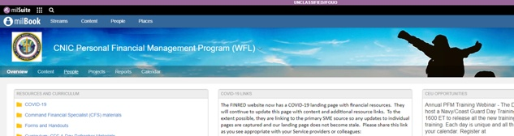

PFM Curriculum
CFSs may only use their branch of service's approved PFM Standardized Curriculum and Touchpoint Curriculum. CFSs are not authorized to use any other material.
SM 15-13

Slide 13





Use Your Resources
Fleet and Family
Support Center
Marine and Family Programs
Army Community
Services
Office of
Work-Life
Airman and Family
Readiness Center

Slide 14
CFS Ratios and Requirements
CFSs assist to CO or OIC
If at least 25 personnel are assigned, there must be 1 CFS
Maintain ratio of 1 CFS to every
75 members assigned
Include active duty and select reserve in numbers
Review service-specific policy for minimum CFS requirements
SM 15-14

Slide 15
Maintaining Your CFS Qualifications
Service Specific
Command Reports
CFS Quarterly Forums
Advance Training
CFS Refresher Course

Slide 16
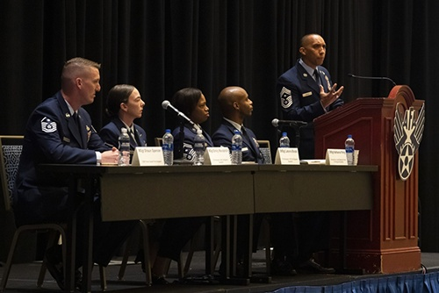
CFS Panel Discussion

Slide 17

Post-test!

Slide 18

Course Evaluation
THANK YOU FOR YOUR FEEDBACK

Slide 19
Graduation
Congratulations, you are a Command Financial Specialist!

