Slide 1
CFS
4
Introduction to Managing Finances

Slide 2
Agenda
Defining Financial Planning
Setting Financial Goals
Financial Planning Pyramid
Activity: What Are My Options?

Slide 3
What Does Financial Planning
Do for You?
Maximize Wealth Earnings
Consume Efficiently
Get Life Satisfaction
Have Financial Security
Accumulate Wealth for Retirement and Estate

Slide 4
Defining Financial Planning
Financial and Insurance Planning
Investment Planning
Retirement Planning
Tax Planning
Estate Planning

Slide 5





Financial Goals
Make your SMART Goals:
Specific
Measurable
Achievable
Realistic
Time-Bound
Short-Term: 1 month – 1 year
Medium-Term: between 1 – 5 years
Long-Term: 5 – 10 years
“Most people don't plan to fail, they fail to plan.” - John L. Beckley
SM
4-3

Slide 6
Financial Goals
Specific
Measurable
Achievable
Realistic
Time-Bound
Weak Goal
SMART Goal
“I want to be rich!”
“I want to have $1M in assets by age 65 by investing $250 per month.”

Slide 7
GOAL: Pay Cash for a New Car (3 Years)
Start savings allotment of $250 per month
Use $5,000 from my SRB/Continuation Pay installment
Sell my current vehicle for at least $7,000
Use my existing savings of $5,000

Slide 8
GOAL: Purchase a Home (5 Years)
Get a copy of my credit report and verify accuracy
Pay off car loan one year early by making double payments each month
Increase my savings allotments to $500 per month to yield $30,000 toward down payment and closing
Activity: Financial Goal Setting

Slide 9
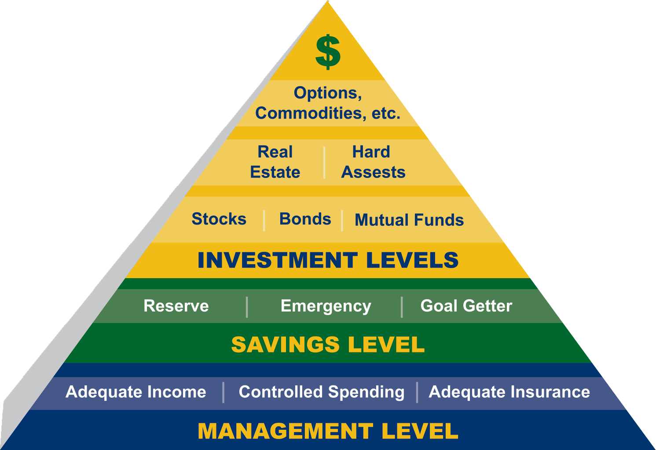
The Financial Planning Pyramid
SM
4 -4

Slide 10
Activity: More or Less?
Suppose you put $1,000 in a savings account and left it alone for five years. If the interest rate was 3% per year, would you have more or less than $1,151?
“Compound interest is the eighth wonder of the world. He who understands it, earns it… he who doesn’t… pays it.” - Unknown

Slide 11
Activity: More or Less?
Imagine that the interest rate on your savings account was 2% per year and inflation was 3.5% per year. After one year, would you be able to buy more or less than today with the money in this account?
https://www.bls.gov/data/inflation_calculator.htm

Slide 12
Effective Spending Plans
Guide and servant
Doesn’t need to be down to the penny
Easy to understand
Reflects wants and needs

Slide 13
Effective Spending Plans
Based on current income and expenses
Practical and realistic
Flexible
Provides for necessities and fun

Slide 14
Benefits of a Written Spending Plan
Live within your income
Realize personal goals
Maintain good credit history
Get more for your money
Reduce financial stress
Enjoy financial freedom

Slide 15
Activity: What Are My Options?
Housing / Utilities
Transportation
Food
Entertainment
Communication
Children and Child Care
Clothing
Digital Spending
Vacations
Holiday Spending
SM
4-5

