Slide 1
CFS
7
Introduction to the
Financial Planning
Worksheet

Slide 2
Agenda
Net Worth
The Budget or Spending Plan
Income
Savings and Living Expenses
Indebtedness
Financial Health Assessment with Action Plan
Debt Destroyer
Financial Links
Chapter Resources
TM

Slide 4
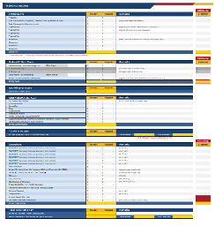
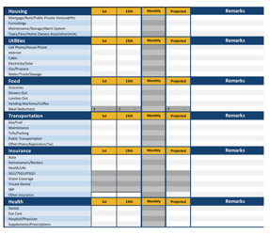
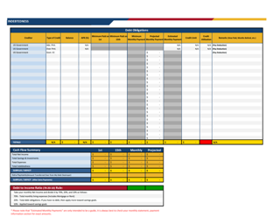
The Budget or Spending Plan
Income
Expenses
Indebtedness

Slide 5
Breakdown of Net Income
Good

Slide 6
Breakdown of Net Income
Better

Slide 7
Breakdown of Net Income
Best

Slide 8
Monthly Income
Gross Income
Total pay and allowances
Net Income
Gross income less taxes
Take-Home Pay
Net Income less deductions or automatic allotments

Slide 9
Calculating Net Income
Example
Gross Income:
$4,200
All Monthly Taxes: $450
$4,200 - $450 =
$3,750
Minus Taxes:
Federal Taxes
State Taxes
Social Security
Medicare
Gross Pay
(Total Pay)
All military pay is taxed. Allowances are not with exception to CONUS COLA.

Slide 10
Savings
Expenses
Emergency
Reserve
Goal Getter
TSP
IRA
Investment
Household and Utilities
Food
Clothing
Transportation
Insurance
Leisure

Slide 11
Why Save?
Emergency Fund
The unexpected
Items paid for regularly, but not monthly
Goal-Getter Fund
Short-term financial goals
Reserve Fund
TSP
Retirement
Investments/IRAs/etc.
Medium-term and long-term financial goals

Slide 12
Emergency Fund Balance
Good
$400
Better
$1000
BEST
3-6 months of living expenses

Slide 13
Living Expenses
Fixed vs Variable
Use the Remarks column
“Back into” the figures needed
Less than 70% of net income

Slide 14
Tracking Expenses
Track spending for 2 – 4 weeks
Record all expenses daily
Group expenditures by category

Slide 15
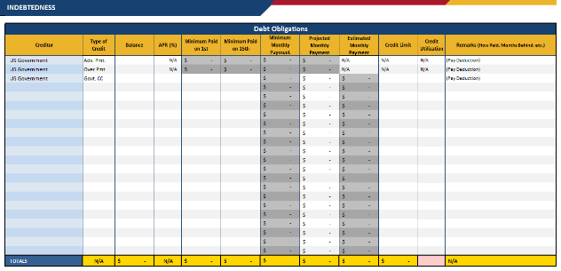
Indebtedness
Creditor
Balance Due
APR
Minimum Monthly Payment
Credit Limit

Slide 16
Cash Flow Summary
Surplus
Deficit

Slide 17
Calculating Debt-to-Income Ratio
Example
Net Income:
$3,750
Minimum Monthly Payments: $680
$680 ÷ $3,750
X 100 = 18.13%
Total Minimum
Monthly Debt Payments ÷
Net Income
Multiply
answer
by 100
SM 7-7

Slide 18
Debt-to-Income Ratio
Target: maximum of 20% of income
< 15%
15% – 20%
21% – 30%
> 30%
Proceed with caution
Adding more debt could put you over 20%
Fully extended
Seek financial coaching to keep debt within recommended limits
Overextended
Strongly encouraged to seek financial coaching
Seriously overextended
Seek help! Contact your local PFM

Slide 19
Debt-to-Income Ratio Activity
Calculate the DTI
1.
2.
Net Income – $2,000
Debt – $200
Net Income – $6,460
Debt – $2,800
3.
4.
Net Income – $3,230
Debt – $555
Net Income – $5,290
Debt – $1,112
Is it a “safe” level of debt?
SM 7-8

Slide 20
Financial Health Assessment
Financial
Summary
Action Plan
Goals

Slide 21
Action Plan
Increase Income and Savings
Decrease Living Expenses
Decrease Indebtedness

Slide 22
Debt Destroyer
TM

Slide 23
Debt Snowball
List debts smallest to largest by balance
Pay minimum required on each
Plus pay extra money toward smallest balance
Celebrate paying off smallest balance
Use old payment plus extra to pay next
Keep going until all are paid off

Slide 24
Debt Snowball
List debts smallest to largest by balance
Pay minimum required on each
Plus pay extra money towards smallest balance
Celebrate paying off smallest balance
Use old payment plus extra to pay next
Keep going until all are paid off

Slide 25
Debt Avalanche
List debts from highest to lowest interest rate
Pay the minimum required starting with highest interest rate
Put any extra money toward highest interest rate debt
Celebrate paying off each debt
Use old payment plus extra to pay next debt listed
Keep going until all are wiped out!

Slide 26
Debt Avalanche
List debts from highest to lowest interest rate
Pay the minimum required starting with highest interest rate
Put any extra money toward highest interest rate debt
Celebrate paying off each debt
Use old payment plus extra to pay next debt listed
Keep going until all are wiped out!

Slide 27
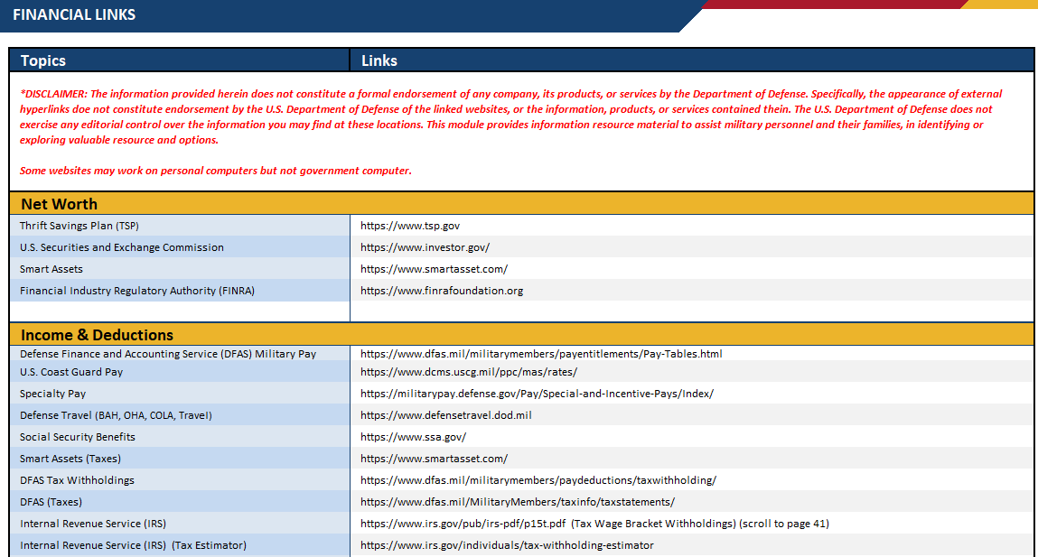
Financial Links

Slide 28
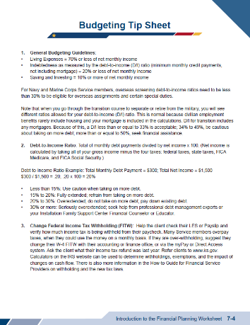
Chapter Resources
SM 7-3 to
7-6

