Slide 1
Military Pay Issues
Personal Financial Management Standardized Curriculum - 2016

Slide 2
Agenda
LES components
Military compensation
Common pay problems

Slide 3
The Importance of Understanding Military Compensation
Know what you are entitled to receive
Manage changes
Manage your money

Slide 4
Military Pay
When you are paid
Direct Deposit System
Changes in pay

Slide 5
Automated System
Monitor your pay
Make changes
Manage your money

Slide 6
Accessing myPay
https://mypay.dfas.mil/mypay.aspx
Create an account
Establish a myPay login
Establish a permanent password
For assistance: DFAS 1-888-DFAS411 or 1-888-332-7411

Slide 7
Navy Cash Card and Split Pay
Check balances
Transfer between accounts
Change your PIN
Transfer account information
Transfer to another account

Slide 8
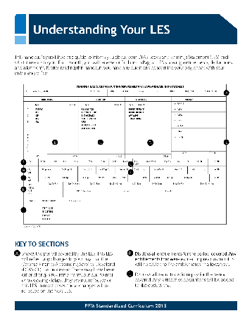
Understanding Your LES
Personal information
Entitlements/deductions/ allotments/summary
Leave summary
Tax information summary
Pay data summary
Thrift Savings Plan summary
Remarks

Slide 9
Pays
Base pay
Special pay
Incentive pays

Slide 10
Allowances
Housing
Living expenses
Moving or travel expenses

Slide 11
Housing Allowances
BAH
COLA
MIHA
OHA

Slide 12
Other Allowances
BAS
Officer: Flat Monthly Rate
Enlisted: Flat Monthly Rate
FSA
FSA – R
FSA – S
FSA – T
CRA
Enlisted: Annually
Officers: Once
12

Slide 13
Travel and Moving Allowances
Mileage/ transportation
Per diem
Miscellaneous
Shipment of goods
Temporary lodging

Slide 14
PCS Allowances
Temporary Lodging Expenses (TLE)
Temporary Lodging Allowance (TLA)
Dislocation Allowance (DLA)
14

Slide 15
Advance Pay
Base Pay
Up to 3 Months
BAH
Up to 3 Months (CONUS)
Up to 12 Months (OCONUS)

Slide 16
Allotments
Discretionary
Non-discretionary
Individual, institution, business
Maximum of six
Designated agency or purpose
No limit

Slide 17
Deductions
Taxes
Insurance
Garnishments
Other pay withholding

Slide 18
Non-Cash Compensation
SGLI and FSGLI
TSP
Medical and dental
Education
Leave
Retirement

Slide 19
Military Tax Issues
FICA
Federal Income Taxes
State Income Taxes

Slide 20
Common Pay Problems
Overpayments and underpayments
Unexpected repayments
PCS and deployment pay issues
Changes in dependent status
Starting and stopping allotments
Too many allotments
Government travel card misuse

Slide 21
Possible Solutions
Monitor LES
Update information on myPay
Keep Page 2 updated
Change withholding
Monitor allotments
Create/monitor spending plan
Use government cards wisely

Slide 22
Repayment Options
Extend repayment
Make payment arrangements
Request a Waiver of Indebtedness

Slide 23
Sources of Help
CFS
FFSC
NMCRS
PSD
VITA
Military OneSource

