Slide 1
Introduction to Touchpoint Curriculum
TC
1

Slide 2
Agenda
What Is Touchpoint Curriculum?
Policy
Financial Literacy Best Practices
Road to Financial Readiness
Learning Objectives
Touchpoint Toolbox
Training Initiation and Completion

Slide 3
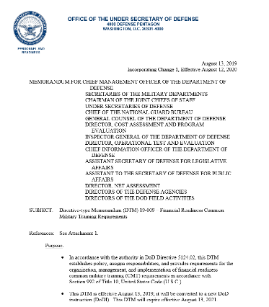
Directive Type Memorandum (DTM) 19-009
Financial Readiness Common Military Training (CMT) Requirements
Provide Service members the knowledge, skills, and behavior standards to manage their financial affairs
August 13, 2019
DTM 19-009

Slide 4
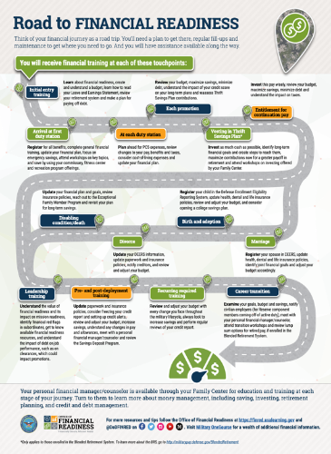
What Are the Touchpoints?
First Duty Station
PCS Moves
Promotion
Vesting in the TSP
Entitlement for Continuation Pay
Disabling Condition
Divorce
Birth and Adoption
Marriage
Leadership Training
Pre- and Post-Deployment
Recurring Required Training
Career Transition
Road to Financial Readiness

Slide 5
5 Principles for Financial Literacy
Know the individuals receiving services
Provide actionable, relevant, and timely information
Improve key financial skills
Build on motivation
Make it easy to make good decisions and follow through

Slide 6
Learning Objectives
Terminal Learning Objectives (TLOs) are organized into six major categories:
Basic Finance
Consumer Protections
Major Purchases
Planning for the Future
Compensation, Benefits and Entitlements
Saving and Investing
DTM 19-009, pages 10 - 11

Slide 7
Terminal Learning Objective (TLO) Matrix
Permanent Change of Station
Vesting in TSP
Entitlement to Continuation Pay
Initial Entry Training
Promotion
Major Life Events
Pre-and Post- Deployment
First Duty Station
Leadership Training
Transition
Recognize the importance of personal financial management and what resources are available | X |  |  |  |  |  |  | X
Identify warning signs of Service members at risk for financial problems | X |  |  |  |  |  |  | X | X
Understand the fundamental of banking services and fees | X | X
Understand the fundamentals of creating and managing a spending plan, and the importance of updating a spending plan |  | X | X | X |  | X | X |  | X | X
Understand the fundamentals and management of debt and credit | X | X | X |  |  |  |  |  | X
Understand fundamentals of income tax and common tax benefits, and potential changes to tax situation |  | X |  |  |  | X | X |  | X | X
Know military consumer protection law fundamentals (SCRA/MLA) | X |  |  |  |  |  |  |  | X
Recognize and understand how to protect yourself from misleading consumer practices, and report complaints |  | X |  |  |  | X |  |  | X
Recognize and identify steps to resolve identity theft |  | X |  |  |  |  |  |  | X
Analyze the implications and identify strategies for financing a major purchase | X | X
Analyze financial implications and identify strategies for buying a car |  | X
Understand education financing, to include available benefits, obligations, and repayment options |  | X |  |  |  |  | X
Basic Finance
Consumer Protections
Major Purchase

Slide 8
Terminal Learning Objective (TLO) Matrix
Notes: Permanent Change of Station applies to Service members in paygrades E-1 to E-4 and O-1 to O-3.
Promotion applies to Service members in paygrades E-1 to E-5 and O-1 to O-4
Major Life Events includes, at a minimum, marriage, birth of first child, divorce, and disabling sickness or condition.
Transition includes separation, transition between Active and Reserve Components, and retirement.
Permanent Change of Station
Vesting in TSP
Entitlement to Continuation Pay
Major Life Events
Leadership Training
Initial Entry Training
Promotion
Pre-and Post- Deployment
First Duty Station
Transition
Comprehend the components of Service member’s military retirement system and the importance of preparing for retirement | X |  |  |  | X | X | X | X |  | X
Discuss the reasons, needs, types, and options for purchasing insurance |  | X |  |  |  |  | X |  | X | X
Understand purpose and implications of estate planning (beneficiaries, will, trust, power of attorney, etc.) | X |  |  |  |  |  | X |  | X | X
Know the components of basic pay and allowances throughout one’s military career | X
Examine the impact of special pay and entitlements |  | X | X |  |  |  |  |  | X
Discuss TRICARE options and costs |  | X |  |  |  |  | X |  | X | X
Discuss survivor and dependent benefits |  |  |  |  |  |  | X |  | X | X
Understand future financial benefits afforded by the Department’s Career Investment Programs |  | X |  | X
Understand interest and how the concept of compounding works |  | X
Recognizer the importance of and be able to develop savings and an emergency fund |  | X |  | X |  |  | X |  | X | X
Describe the fundamentals of investing |  | X
Understand and be able to manage a Thrift Savings Plan (TSP) account |  | X |  | X | X |  |  |  | X | X
Planning for the Future
Compensation, Benefits, and Entitlements
Saving and Investing

Slide 9
CFS Reference Manual Description
Section I: Introduction to Touchpoint
Section II: Learning Objectives (TLOs and ELOs)
Section III: References
Section IV: Acronyms
Section V: Touchpoint Toolbox
Section VI: Additional Learning and Activities

Slide 10
Touchpoint Toolbox
One on One
Checklist and handouts
Classroom
Checklists and handouts
PowerPoint (PPT) Training Slides and Instructor Guide (IG)
Videos and Video Discussion Guides (VDG)
Online Training
Coast Guard e-Learning site: elearning.uscg.mil

Slide 11
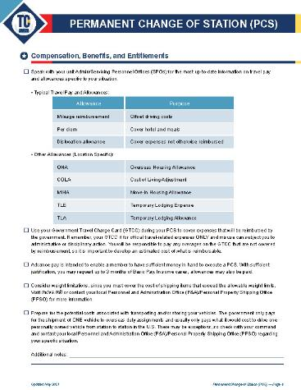
One on One: Touchpoint Checklists and Handouts
TC 3 Permanent Change of Station (PCS) Member Checklist

Slide 12
Classroom Instruction: PowerPoint and Instructor Guide

Slide 13
Classroom Instruction: Video and Video Discussion Guides
TC 6 Continuation Pay Video Discussion Guide

Slide 14
Online: USCG e-Learning

Slide 15
Where Is My Touchpoint Toolbox?
Office of Financial Readiness (FINRED), CG Resource Page:
finred.usalearning.gov/CoastGuardResource
CFS milSuite site: milsuite.mil/book/groups/uscg-cfs-resources
CG e-Learning site: elearning.uscg.mil

Slide 16
Training Initiation and Completion for Coast Guard
Coast Guard Message directs Coast Guard member to CFS or PFM for assistance.
CFS or PFM delivers Touchpoint Curriculum or refers Coast Guard member to Coast Guard e-Learning site.
Upon completion, Coast Guard member provides verification of completed training by using the CG e-Learning site self-certify option. Member will be directed to input date of completion and counselor name in the CG e-Learning site.

Slide 17
Summary
Thank you for completing the Introduction to Touchpoint Curriculum.
Let’s recap what you learned:
What Is Touchpoint Curriculum?
Policy
Financial Literacy Best Practices
Road to Financial Readiness
Learning Objectives
Touchpoint Toolbox
Training Initiation and Completion

Slide 18
Resources
Checklist and Handouts
Financial Education and Support
Command Financial Specialists (CFS)
Personal Financial Managers (PFM)
Health, Safety and Work-Life (HSWL) Regional Practice
CG SUPRT
Coast Guard Mutual Assistance (CGMA)
Financial Literacy Mobile Apps
Coast Guard Work-Life mobile app
DoD FINRED Sen$e mobile app

Slide 19
Questions?
The appearance of U.S. Department of Homeland Security visual information does not imply or constitute DHS endorsement.

