Slide 1
Vacation Planning
Personal Financial Management Standardized Curriculum - 2016

Slide 2
Agenda
Planning tips
Ways to cut costs
Fit expenses into your budget

Slide 3
Planning Your Vacation
Select location then set limit
Set limit then choose location

Slide 4
Vacation Expenses
Transportation
Lodging
Food
Entertainment
Incidentals

Slide 5
Military-Only Options
Morale, Welfare and Recreation
Armed Forces Recreation Centers
Armed Forces Vacation Club
Military Lodging
Space-A travel

Slide 6
Funding Your Vacation
Vacation budget
Savings
Credit

Slide 7
Budgeting for Future Vacations
Do post-vacation analysis
Review spending plan
Set up plan for next trip
Put aside funds monthly

Slide 8
Ways to Save
List two vacation destinations
List five ways to save
List one way to reduce current expenses

Slide 9
Summary
Save money
Avoid debt accumulation
Reduce stress
Set the stage for your vacation

Slide 10
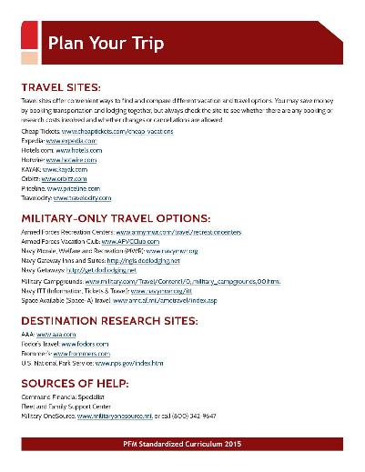
Resources
CFS
FFSC
Military OneSource

